Slide 1
Awaken: An Overview

Slide 2
AWAKEN MISSION STATEMENT
We seek to increase awareness and education surrounding the issue of commercial sexual exploitation and to provide housing and restoration for its victims
Notes:
Awaken provides direct services to help women transition out of commercial sexual exploitation. Since its inception, Awaken has worked directly with over 300 victims of Commercial Sexual Exploitation
Case management, counseling, mentorship relationship and love:
Pumpkin carving, gingerbread house making, spa nights, camping, water Wednesdays in the summertime.
Took two to Mexico to give back and serve at an orphanage.
And more seriously,
16 women get their own apartments/housing.
7 Jobs – one of which is her own business license
5 in School
3 had babies

Slide 3
Sex Trafficking
Occurs when a commercial sex act is induced by force, fraud or coercion OR when the person induced to perform the commercial sex act is under 18 years old
Commercial Sex Act
Any sex act on account of which anything of value (money, drugs, shelter, food, clothes, etc.) is given to or received by any person
Notes:
The age of the victim is the critical issue — there is no requirement to prove force, fraud, or coercion was used to secure the victim’s actions. The law recognizes the effect of psychological manipulation by the trafficker, as well as the effect of threat of harm which traffickers/pimps use to maintain control over their young victims.

Slide 4
Myth
Myth: Child sex trafficking could never occur in my community
Truth: Heatmap

Slide 5
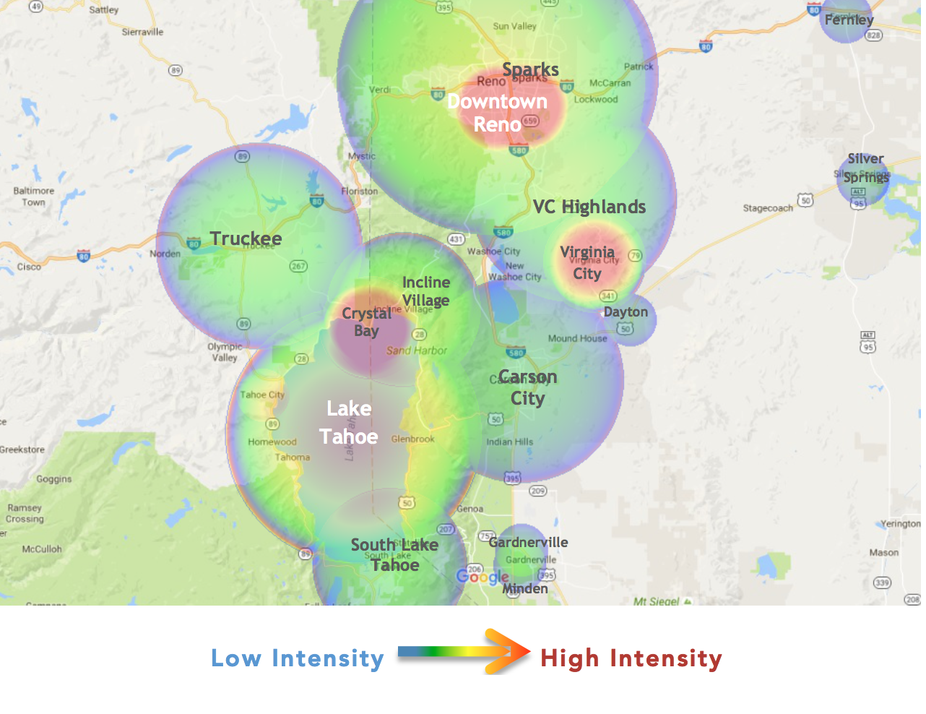
Sexual Exploitation in Our Community
1500
#fight4someone
Notes:
Crystal Bay………………………………………..8-10
Emerald Bay……………………………………….0-1
Incline Village……………………………………,40-45
North Lake Tahoe……………………………..2-3
South Lake Tahoe………………………………50-55
Tahoe City………………………………………….0-2
Truckee………………………………………………60-65
Lake Tahoe………………………………………..200-225

Slide 6
Our services
Prevention
Awareness presentations to students, educators, churches, and parents
Restoration
Case Management
Therapy (group and individual)
Drop-in Center
Housing Program
City Transformation
Awareness presentations and partnerships with community groups, law enforcement, care givers, etc.

Slide 7
Shontell Brewer
info@awakenreno.org
775-393-9183

